Slide 1
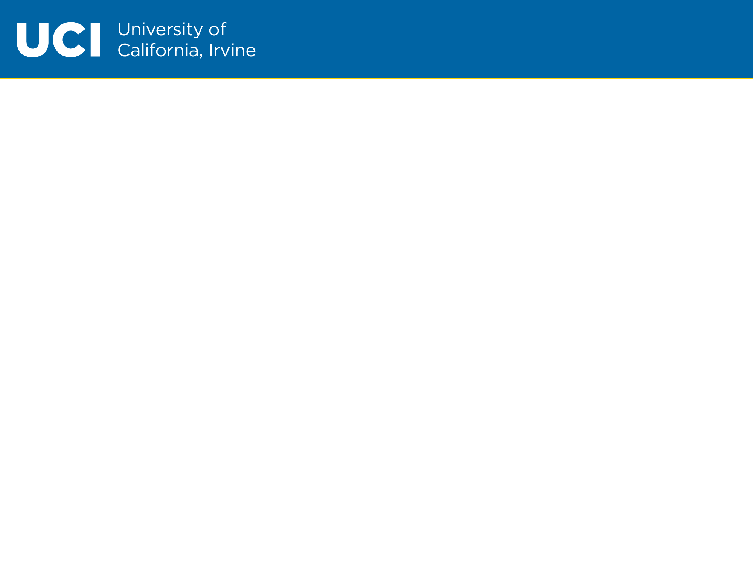
NHL Dashboard
Sherry, Julie, Josh, Tommy
https://nhl-dashboard-app.herokuapp.com/

Slide 2
Our Idea
Create and interactive site for fans of the NHL to find visualizations of their favorite teams.
Radar for each team to visualize strengths
Scrape Twitter to find overall sentiment of each team
Compare last game played vs another team

Slide 3
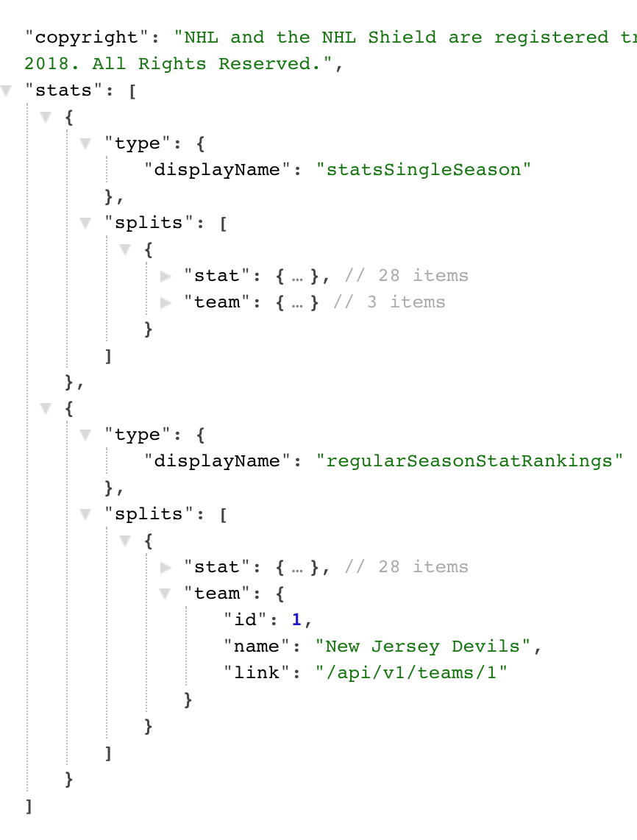
Data Source
NHL’s Undocumented API
http://statsapi.web.nhl.com/
Returns JSON data

Slide 4
The Stack
Front End: HTML, CSS, JS, Bootstrap, D3.js
Back End: Python, Flask-PyMongo
Database: MongoDB
Server Framework: Flask
Graphing Library: Chart.js
Version Control: Git via Github

Slide 5
Data Flow
Starts with a Python API request to NHL
Returned Data is stored in a cloud MongoDB collection
When Flask app runs data is collected from Mongo and sorted into DataFrames with Pandas. Selected Dataframe columns are JSONifed at each route.
D3.js fetches JSON from flask route in a promise. After the promise is executed chart.js generates graphs.
HTML loads app.js graphs by id
DB
MongoLab
(MongoDB Cloud)
Server
Heroku
Client
HTML
CSS
JS
Pandas

